Slide 1
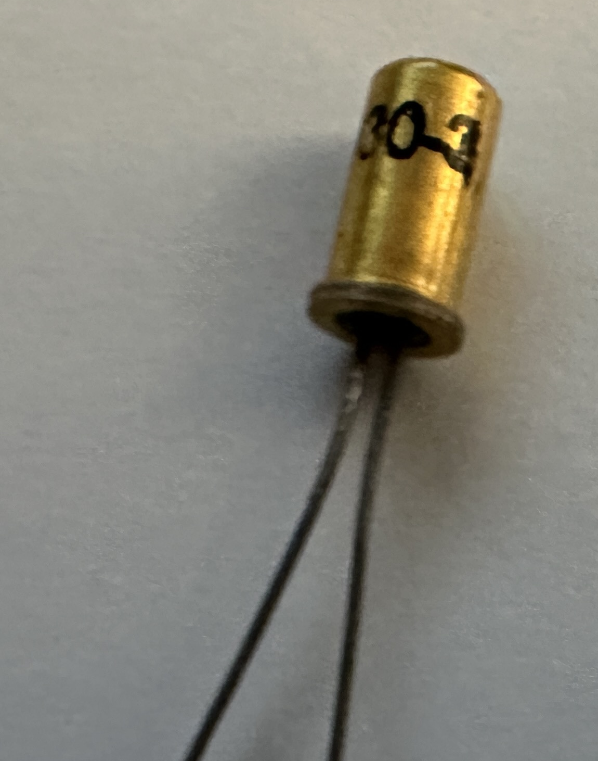
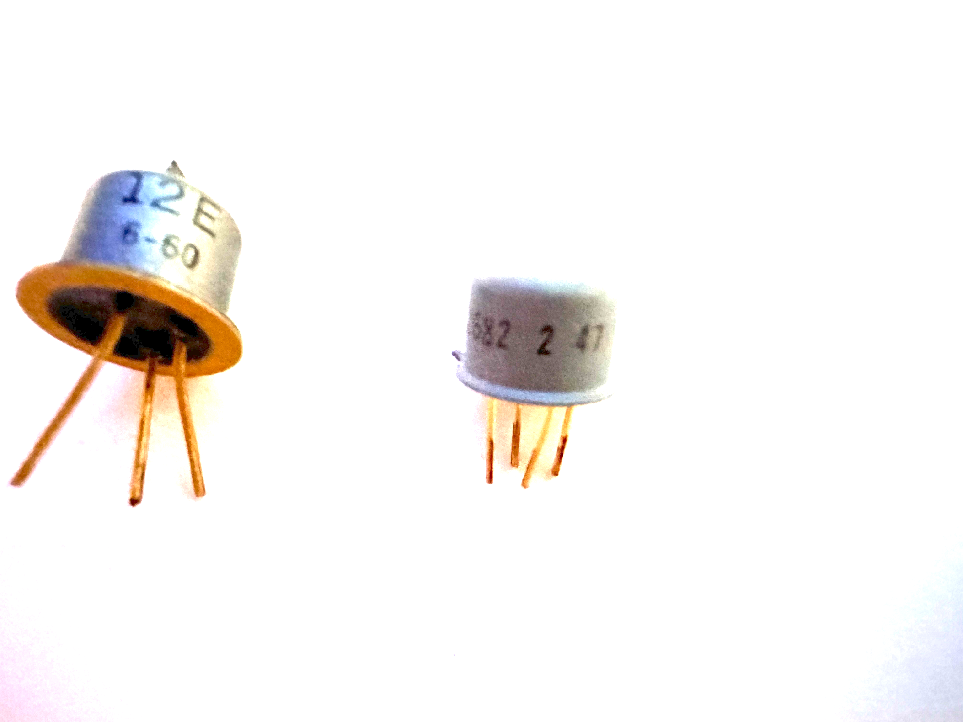
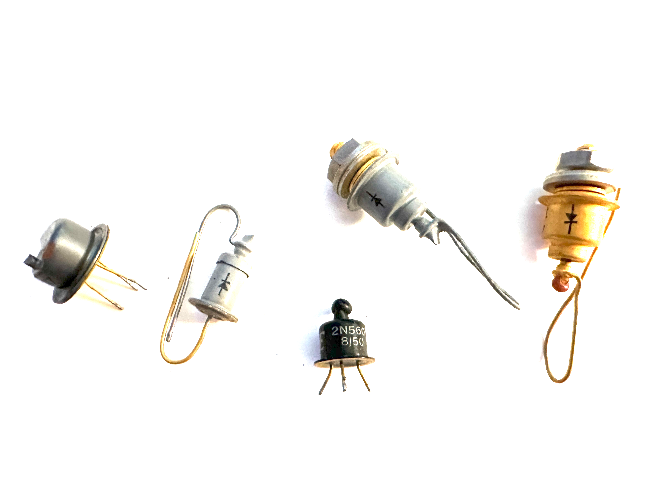
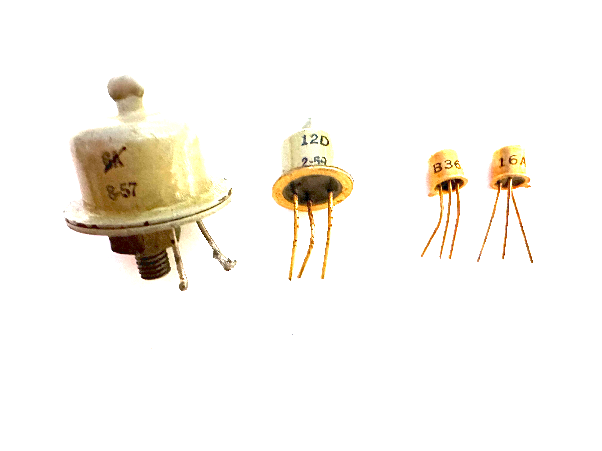
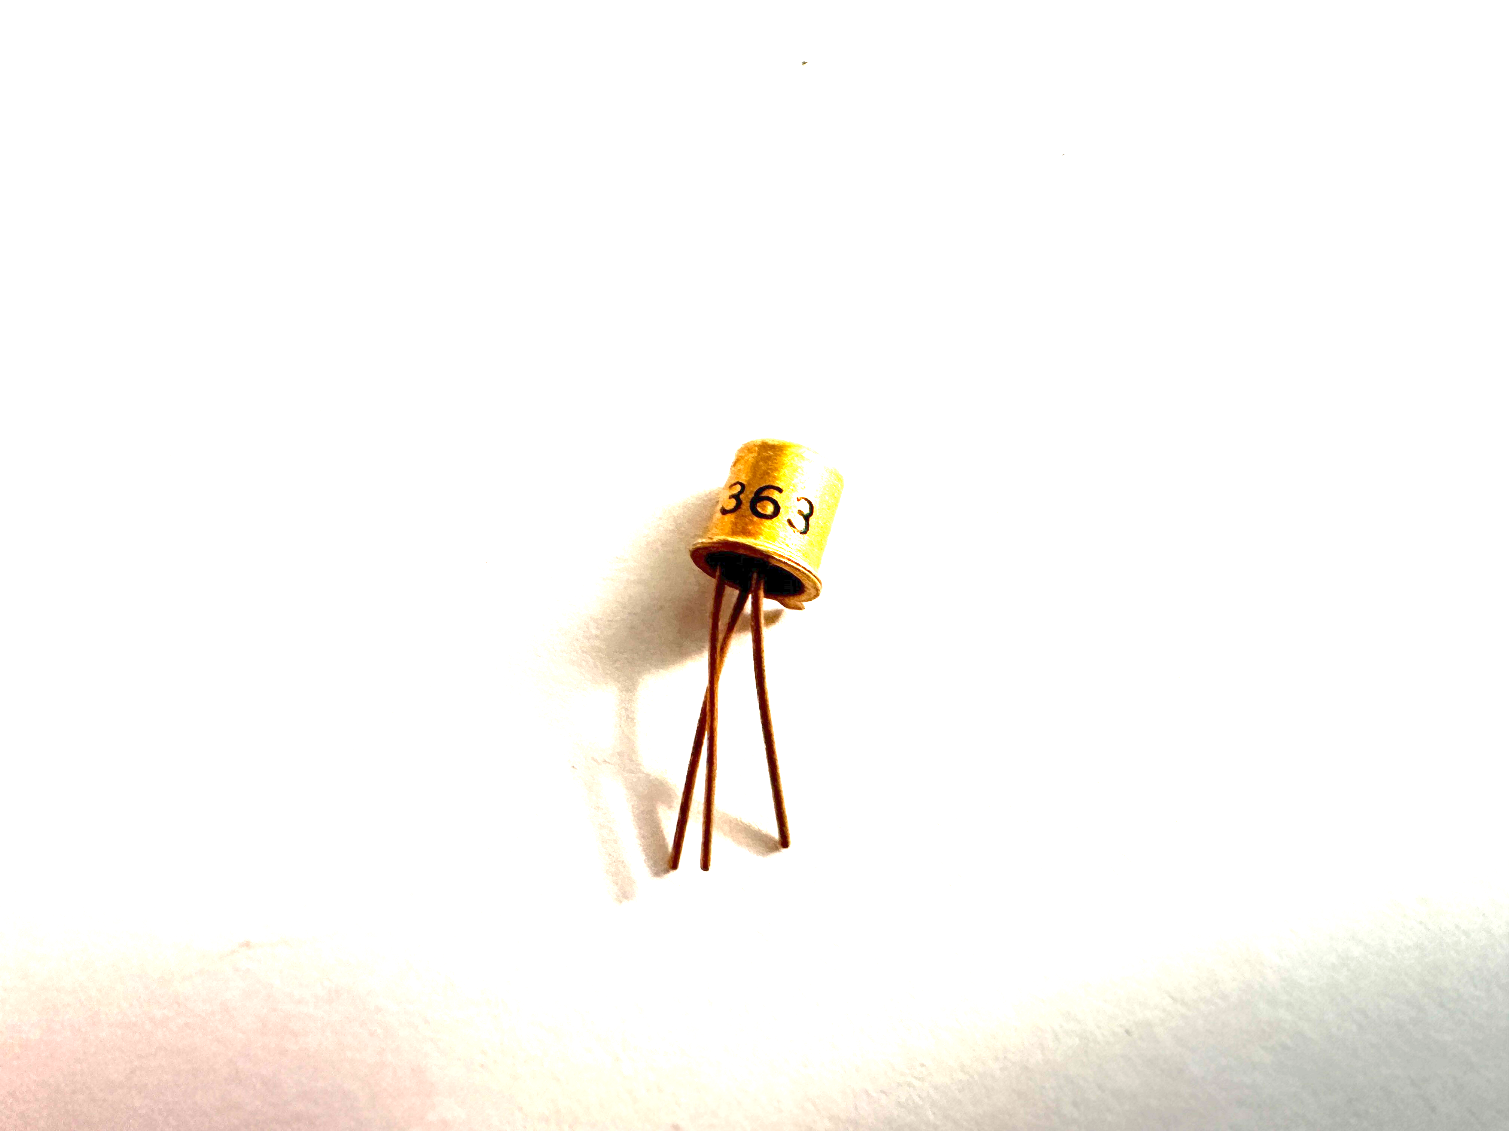
CDL Presents Basic Electronics
(Joseph E Wilkes, photo)
(Joseph E Wilkes, photo)
Week 2
Diodes and Transistors
Joe Wilkes, PhD
WA2SFF
(Joseph E Wilkes, photo)
(Joseph E Wilkes, photo)

Slide 2
Questions from Last Week

Slide 3
How Semiconductor Devices Are Made
Many Semiconductors are made from either
Germanium
Silicon
Silicon Carbide (SiC) for high power, temperature applications, and
Gallium nitride (GaN) (alloyed with Al and P) for visible LEDs
When a small amount of an impurity is added, the electrical properties of the material change and create
N material, or
P material
By sandwiching P and N material together a semiconductor is made

Slide 4
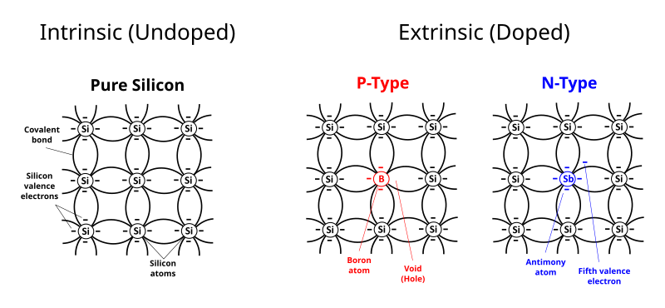
Example of Doping of Silicon
Silicon P Type is doped with:
Boron
Aluminum
Gallium
indium
Silicon N-type is doped with:
Phosphorus
Arsenic
Antimony
Bismuth
Lithium
https://en.wikipedia.org/wiki/Doping_(semiconductor)

Slide 5
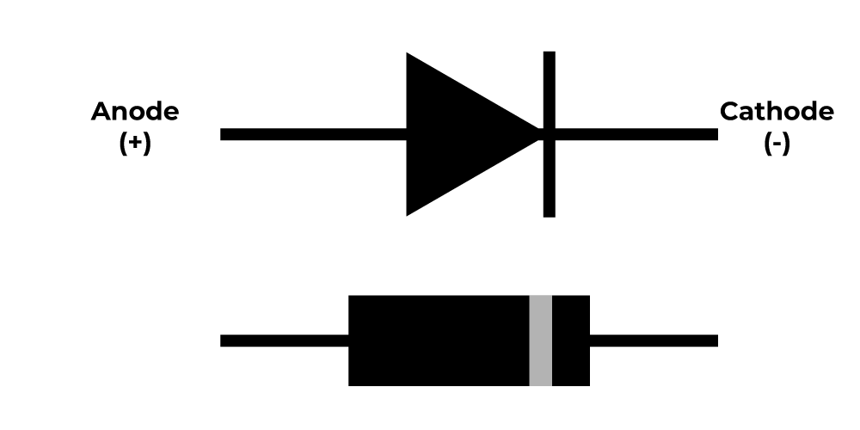
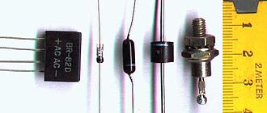
Diodes
Diodes are electronic components that only conduct electricity in one direction
They are useful for converting AC signals into DC signals
There are several kinds
Germanium Diodes
Silicon Diodes
Schottky Diodes
Light Emitting Diodes
Zener Diodes

Slide 6
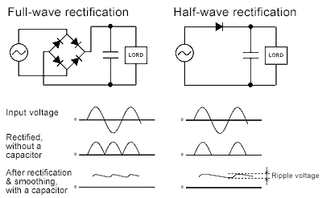
Diodes convert AC to DC
https://techweb.rohm.com/product/power-device/si/19487/

Slide 7
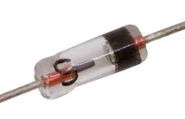
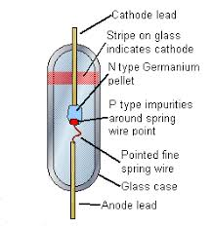
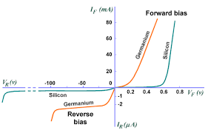
Germanium Diodes
Germanium were one of the first diodes to be made.
Germanium conducts electricity
Adding impurities to the germanium makes it:
P type (positive)
N type (negative)
P-type attached to N-type makes a diode
They were used in early crystal radios
There is a nominal forward voltage drop of 0.2 volts

Slide 8
Common germanium diodes
Examples: 1N34, 1N270, 1N60
Germanium diodes are now considered obsolete and are not widely produced
They are mostly used is simple receivers
Finding these diodes in new stock can be difficult, and they are often sourced from surplus or vintage electronic suppliers
Sometimes vendors will sell " Germanium" diode that are really Silicon diodes
If you see a bunch at a flea market and need them, buy the entire lot.
Sometimes Schottky diodes are used in simple receivers since they are readily available

Slide 9
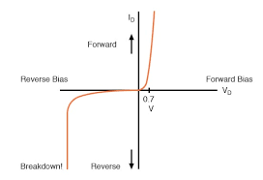
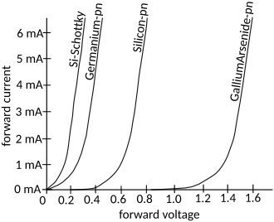
Silicon Diodes
Silicon Diodes are used for:
Low power applications
High power applications
There is a nominal forward voltage drop of 0.7 volts

Slide 10
Common Silicon diodes
Rectifier diodes
High Breakdown voltage
High Current Handling
Examples: 1N400X; e.g., 1N4001, 1N4007, etc.
Small Signal Diodes
Used to limit small signals in amplifiers
Examples: 1N4148, 1N914

Slide 11
Schottky Diode
Diodes have a maximum frequency where they work correctly
In very high frequency electronics, when a germanium or silicon small signal diode will not work, Schottky diodes are used
There is also a diode called a Shockley diode which is different
Commonly encountered Schottky diodes include the 1N58xx series rectifiers,
1N581x and 1N582x through-hole parts, and
SS1x and SS3x surface-mount parts.
Early Shockley diode,
from collection of Joseph E Wilkes, (photo)

Slide 12
Gallium Arsenide Diodes
Gallium arsenide (GaAs) diodes,
including PIN diodes and Gunn diodes,
offer advantages like
high-speed switching and
low noise,
making them suitable for various applications, particularly in microwave and high-frequency circuits.

Slide 13
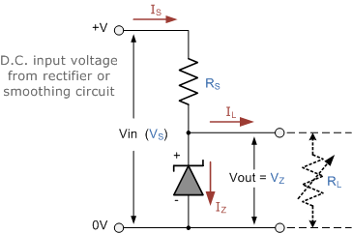
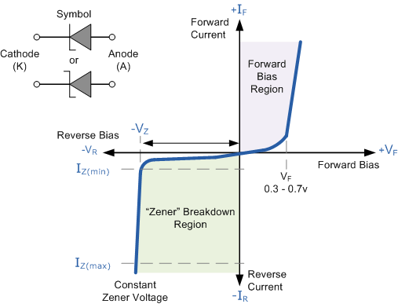
Zener Diodes
All diodes have a break down voltage when the polarity is reversed
Zener diodes are special diodes where the break down voltage is tightly controlled
It is put in the circuit in the reverse direction
They are available for many different voltages

Slide 14
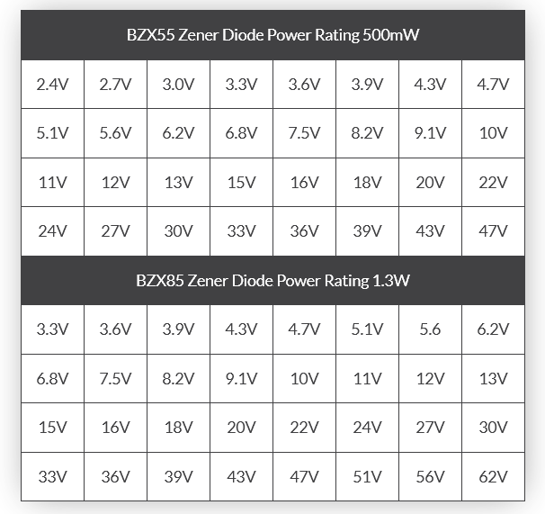
Example Zener Diodes

Slide 15
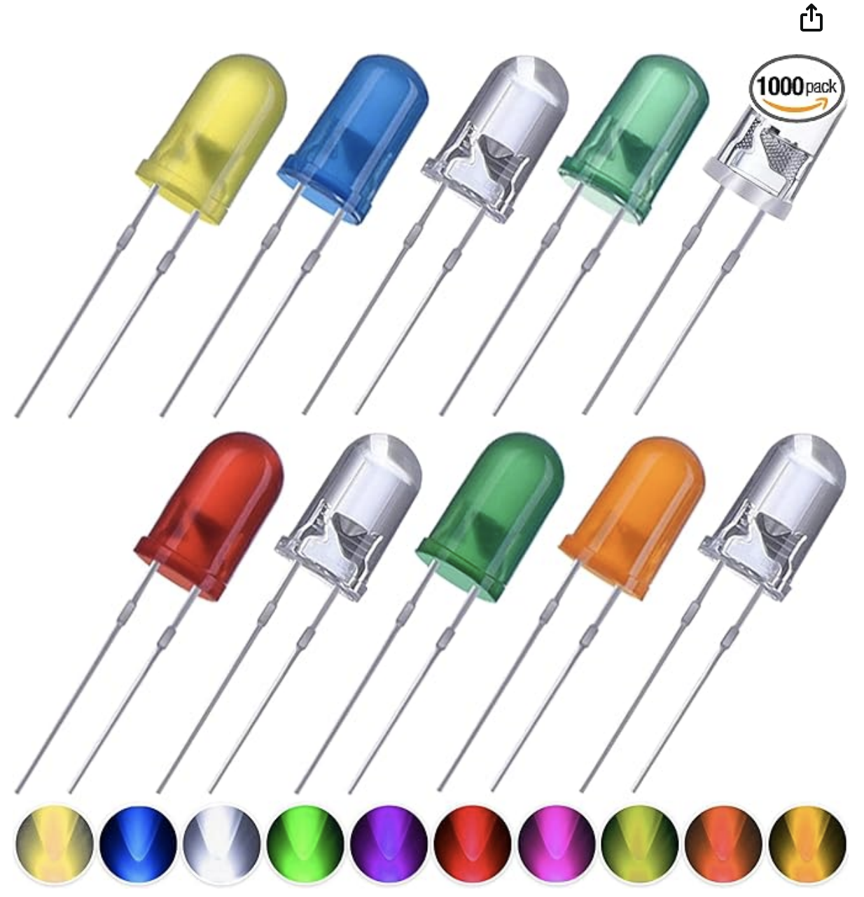
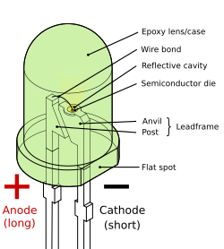
Light Emitting Diodes
Light emitting diodes (LED) generate light in visible, ultraviolet and infrared ranges when connected to a DC voltage
Made from Gallium nitride (GaN)
Each "color" has a different voltage drop
LEDs can not be put in parallel
They can be put in series
They come in physical different sizes

Slide 16
Colors and Voltage drop
Color Wavelength (nm) Voltage drop
White all 2.7 < ΔV < 3.5 volts
Infrared λ > 760 ΔV < 1.9 volts
Red 610 < λ < 760 1.63 < ΔV < 2.03 volts
Orange 590 < λ < 610 2.03 < ΔV < 2.10 volts
Yellow 570 < λ < 590 2.1 < ΔV < 2.18 volts
Green 500 < λ < 570 1.9 < ΔV < 4 volts
Blue 450 < λ < 500 1.63 < ΔV < 2.03 volts
Violet 400 < λ < 450 2.76 < ΔV < 4.0 volts
Purple mixture of LEDs 2.48 < ΔV < 3.7 volts
Ultraviolet λ < 400 3.1 < ΔV < 4.4 volts

Slide 17
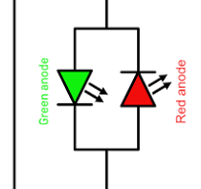
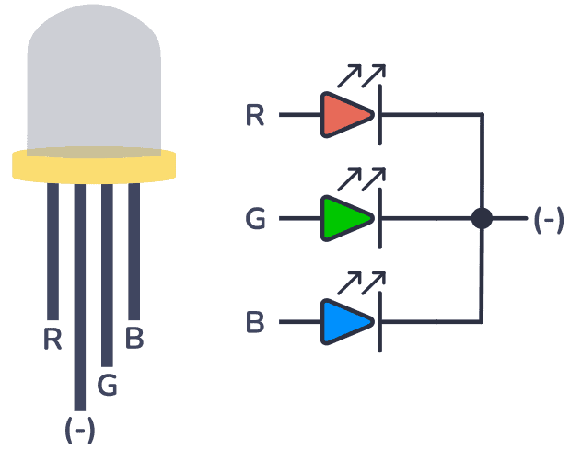
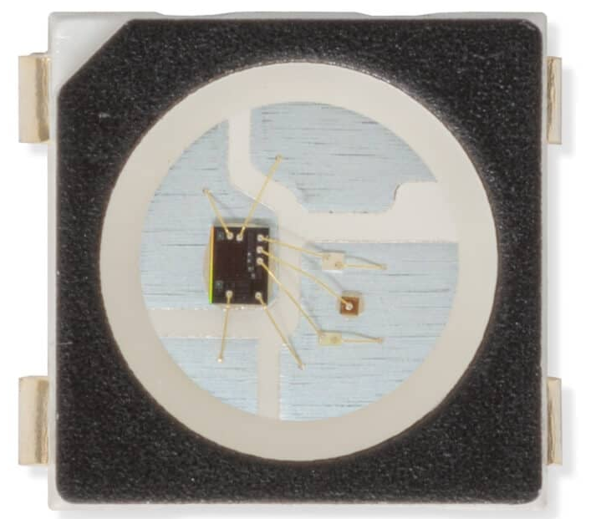
Other types of LEDs
Red/Green LEDs
A Red LED and a Green LED are put in parallel
Current in one direction lights the Red LED
Current in the other direction lights the Green LED
Red/Green/Blue LEDs
There are 3 LEDs (Red, Green, Blue) close to each other
The color is then a combination of the three color LEDs
Some are special in that there is a chip inside the LED
The chip decodes an address and a value of brightness for each LED
They are often found in long strips with each LED having a different address
They are controlled by microprocessors

Slide 18
Transistors
Unlike vacuum tubes, where a tube part is very similar to other tubes of the same part number,
Transistors have a wide range of specifications for the same part number
Designs of transistor circuits must account for the range
Types of Transistors
BiPolar PNP and NPN Transistors
Field Effect Transistors (FET)
Gallium Arsenide Transistors (GAs-FET)
Darlington pairs
Opto isolators

Slide 19
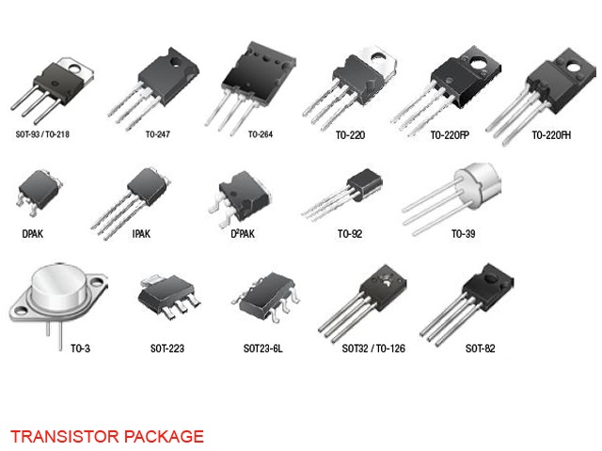
Transistor Packages

Slide 20
Germanium and Silicon Transistors
The transistor was invented by Walter Brattain, John Bardeen and William Shockley,
at Bell Telephone Laboratories in Murray Hill, NJ,
on December 23, 1947
They later shared the Nobel Prize in Physics for the breakthrough they achieved
Bell Labs folk lore has it that the team was told to stop development on this worthless project.
They did not listen
This became the mantra of employees when working on new projects

Slide 21
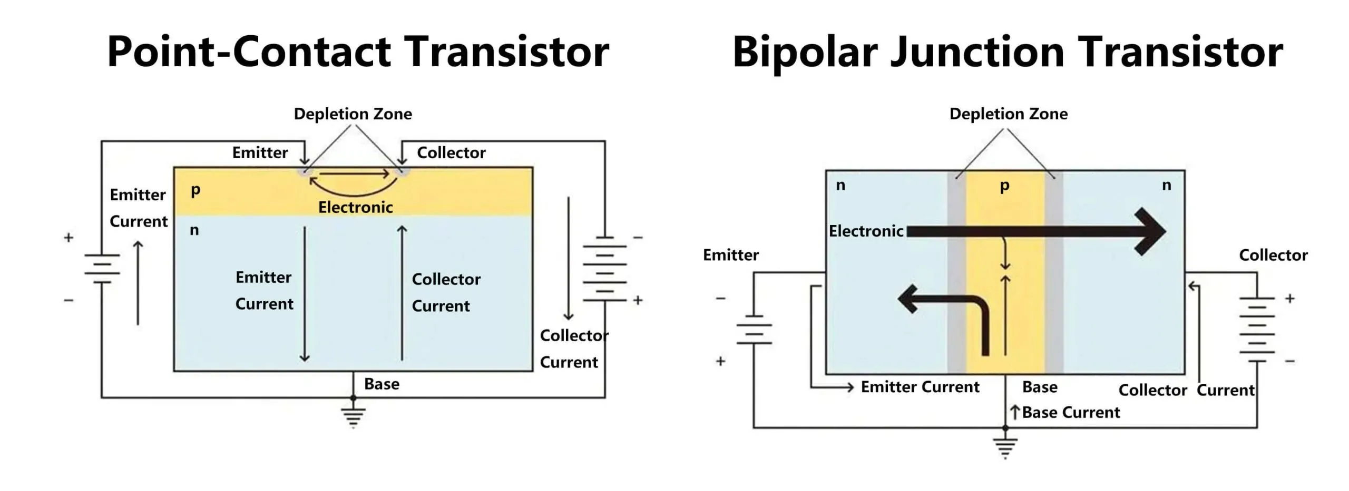
Two Types of Transistors
https://spectrum.ieee.org/transistor-history

Slide 22
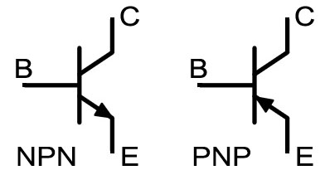

Common bipolar transistors
Small signal NPN
2N2222
2N3904
Small Signal PNP
2N3906
PNP NPN
Bipolar Transistor

Slide 23
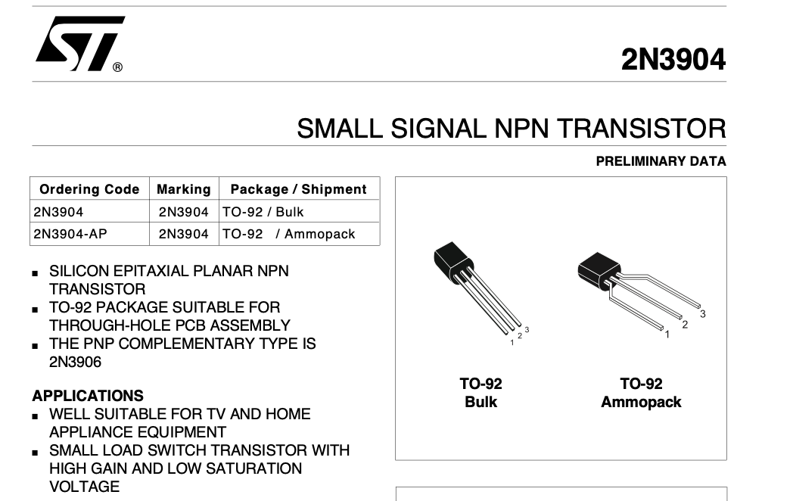
Transistor Data Sheet example - 1
https://cdn.sparkfun.com/assets/7/9/2/7/6/2N3904.pdf

Slide 24
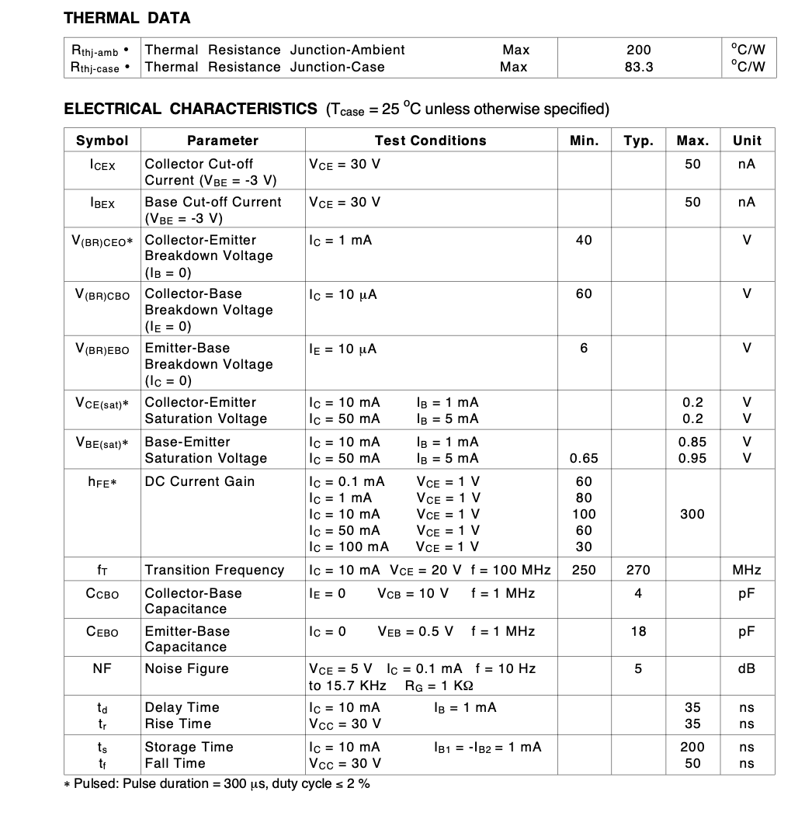
Transistor Data Sheet example - 2
Gain
Approximate Maximum Frequency
Capacitance

Slide 25
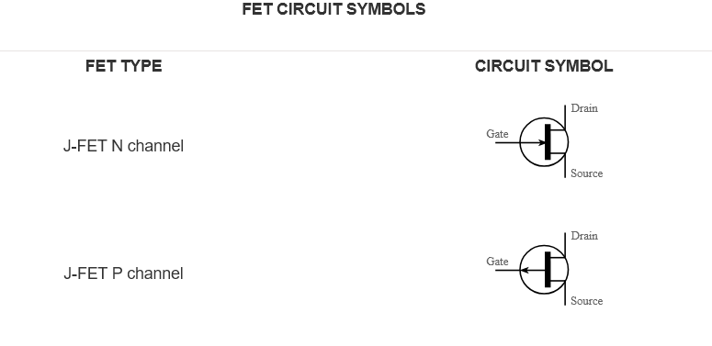
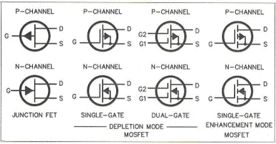
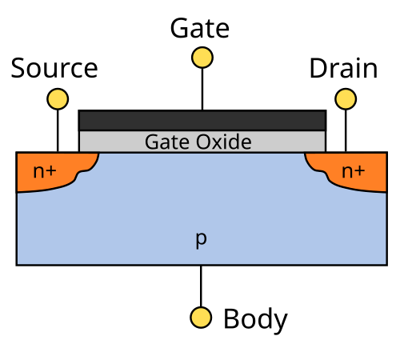
Field Effect Transistors
Bipolar Transistors have low impedance and work on current
Field Effect Transistors work on voltage and have a high impedance
There are two main types
J-FET
MOS-FET
J-FET are used for small signals
MOS-FET range from small signals to very high power circuitry

Slide 26
Some Commonly used FETs
J-FET: MPF102, J310
MOSFET:
small signal: 3N200
power: IRF9540

Slide 27
Gallium Arsenide FET (GaAs FET)
Used in microwave circuits
Have very low noise
Specialty part that needs to be picked for the design frequency

Slide 28

Darlington Transistor
Some transistors do not have enough gain
So by connecting the emitter of one transistor to the base of a second one, and
Connecting the collectors of both together
A Darlington Transistor is created
Some times circuits will be created with two transistors
There are also Darlington Transistor parts with everything inside the package

Slide 29
Light Sensitive Transistors
Some materials can be sensitive to light; this is called the photo-electric effect
When light hits a transistor, current will flow
In the late 19th century, and early 20th century scientists could not explain this effect
The German physicist Max Planck suggested that a beam of light is not a wave propagating through space, but has discrete energy packets, which were later called photons
Albert Einstein published a paper advancing the hypothesis that light energy is carried in discrete quantized packets to explain experimental data from the photoelectric effect.
Einstein was awarded the 1921 Nobel Prize in Physics for "his discovery of the law of the photoelectric effect"
https://en.wikipedia.org/wiki/Photoelectric_effect

Slide 30
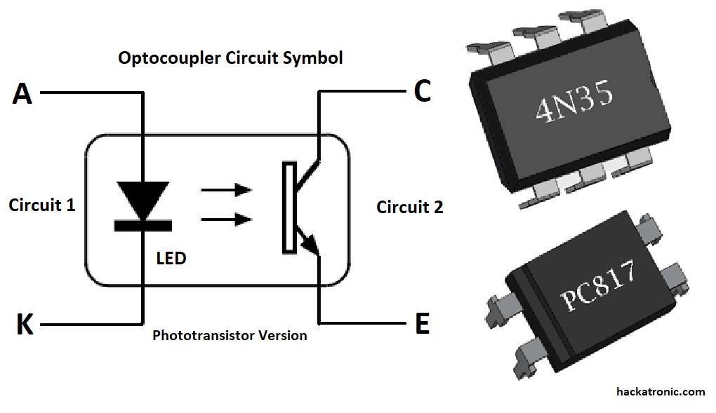
Optoisolators
When it is necessary to isolate part of a circuit from another part of the circuit, an optoisolator is used.
An LED is put in the same package as a transistor that is light sensitive.
An example is connecting two devices in different racks where it is necessary to isolate the grounds from each other.
Optoisolators are digital devices
When the LED is on, the C to E resistance is very low
When the LED if off, the C to E resistance is very high

Slide 31
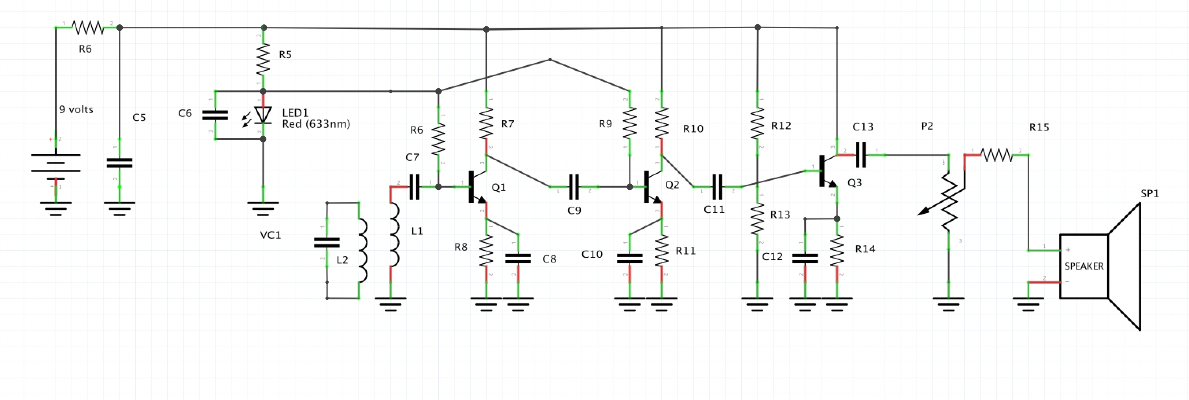
Example: Simple AM Receiver
We are going to analyze the circuit inside the dotted box

Slide 32
Analysis of NPN Transistor Amplifier
R0
R8 = 2200 ohms = 2.2 k ohms
R6 = 6.8 k ohms
R7 = 4.7 k ohms
V1 = 1.6 volts (drop of red LED)
V2 = 9 volts (battery)
V1
IC
V2
IB
VC
VB
VE
IE

Slide 33
Equations
VE = R8*IE=R8*(IB+IC)
VB = VE+0.7
VC= V2-IC*R7
IE= VE/R8
IB = (V1-0.7-VE)/R6
IC = G*IB
G – Gain of transistor = IC/IB
R0
V1
IC
V2
IB
VC
VB
VE
Solving for IB gives:
IB = (1.6-0.7)/(R6+(G+1)*R8)
IE

Slide 34
Spread sheet Analysis
R8 | 2.2
R6 | 6.8
R7 | 4.7
V1 | 1.6
V2 | 9
 |  | G | IB | IE | IC | VB | VE | VC
 |  | Gain | Base Current | Emitter Current | Collector Current | Base Voltage | Emitter Voltage | Collector Voltage
 |  | 10 | 0.0290 | 0.3194 | 0.2903 | 1.40 | 0.70 | 7.03
 |  | 20 | 0.0170 | 0.3566 | 0.3396 | 1.48 | 0.78 | 6.69
 |  | 50 | 0.0076 | 0.3857 | 0.3782 | 1.55 | 0.85 | 6.43
 |  | 100 | 0.0039 | 0.3969 | 0.3930 | 1.57 | 0.87 | 6.33
 |  | 150 | 0.0027 | 0.4009 | 0.3982 | 1.58 | 0.88 | 6.29
 |  | 200 | 0.0020 | 0.4029 | 0.4009 | 1.59 | 0.89 | 6.27
 |  | 250 | 0.0016 | 0.4041 | 0.4025 | 1.59 | 0.89 | 6.26
 |  | 300 | 0.0013 | 0.4049 | 0.4036 | 1.59 | 0.89 | 6.26
 |  | 350 | 0.0012 | 0.4055 | 0.4044 | 1.59 | 0.89 | 6.25
 |  | 400 | 0.0010 | 0.4060 | 0.4049 | 1.59 | 0.89 | 6.25
 |  | 500 | 0.0008 | 0.4066 | 0.4058 | 1.59 | 0.89 | 6.24
 |  | 600 | 0.0007 | 0.4070 | 0.4063 | 1.60 | 0.90 | 6.24
 |  | 700 | 0.0006 | 0.4073 | 0.4067 | 1.60 | 0.90 | 6.23
 |  | 800 | 0.0005 | 0.4075 | 0.4070 | 1.60 | 0.90 | 6.23
 |  | 900 | 0.0005 | 0.4077 | 0.4072 | 1.60 | 0.90 | 6.23
 |  | 1000 | 0.0004 | 0.4078 | 0.4074 | 1.60 | 0.90 | 6.23

Slide 35
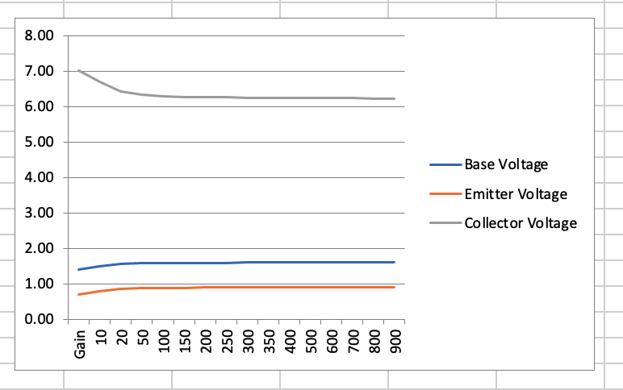
Voltages vs gain of transistor
The beauty of this design is that the voltages are almost independent of the gain of the transistor once the gain is at least 50.
Thus, you can change transistors without changing the circuit design.

Slide 36
Questions

Slide 37
References
Radio Amateur's Handbook, ARRL, Newington CT
https://www.amazon.com/ARRL-Handbook-Radio-Communications-101st/dp/1625952074
https://www.elenco.com/wp-content/uploads/2017/10/ECK-10_REV-O-2.pdf
https://www.infobooks.org/free-pdf-books/physics/electronics/

